Slide 1
CELLERGIZE MORNING
PRODUCT EDUCATION

Slide 2
At LifeWave, we believe in the transformative power of synergy. Our mission is simple: to enhance your health and vitality in the best way possible.​
This vision drives our groundbreaking approach to wellness, where cutting-edge technology meets the science of nutrition. ​
Introducing LifeWave Cellergize Morning, a scientifically crafted supplement designed to complement our innovative LifeWave patches, offering a holistic solution to your well-being.*​
*These statements have not been evaluated by the Food and Drug Administration. These products are not intended to diagnose, treat, cure, or prevent any disease.

Slide 3
WELLNESS POWERHOUSE IN EVERY SERVING
5 Essential Minerals: Copper, Selenium, Zinc, Potassium, Magnesium​
4 Amino Acids: Glycine, L-Lysine, Beta-Alanine, Citrulline​
2 Important Electrolytes: Potassium, Magnesium​
1 Vital Vitamin: Vitamin C​
1 Plant extract: CyanthOx™ - Sea buckthorn fruit extract​
2 Powered by amino-acid science: NAC (N-Acetyl Cysteine) and Creatine​

Slide 4



CELLERGIZE MORNING:
START STRONG, POWER ON.​
Set the pace for the day ahead. Introducing Cellergize Morning, made for you to create a foundation of living well every day. An energizing blend of essential vitamins, minerals, and amino acids, Cellergize Morning revitalizes your body, sparks ambition, and boosts results. Packed with a dynamic blend of ingredients, it’s your go-to boost for feeling refreshed, motivated, and ready to conquer whatever comes your way. Flavored with lemon and ginger, this refreshing morning wellness supplement includes sea buckthorn fruit extract, which supports healthy stem cell activity.* Supercharge your results with the complementary benefits of LifeWave’s powerful patch technology.​
Supports healthy stem cell activity with the power of sea buckthorn fruit extract.*​
Provides nutrients known to support overall health and wellness​*​
Designed with a blend of key ingredients to revitalize your wellbeing​*​
Utilizes ingredients known to support health and vitality of human cells​*​
Complements LifeWave’s line of non-transdermal patches *
Non-GMO
No artificial sweeteners,
flavors or colorings ​
Gluten free
*These statements have not been evaluated by the Food and Drug Administration. These products are not intended to diagnose, treat, cure, or prevent any disease.

Slide 5

CELLERGIZE INGREDIENTS WORK TOGETHER TO REVITALIZE WELLNESS.*
Crafted with a unique blend, it’s thoughtfully designed to complement our innovative non-transdermal patches—offering a holistic approach to health and vitality.*

Slide 6
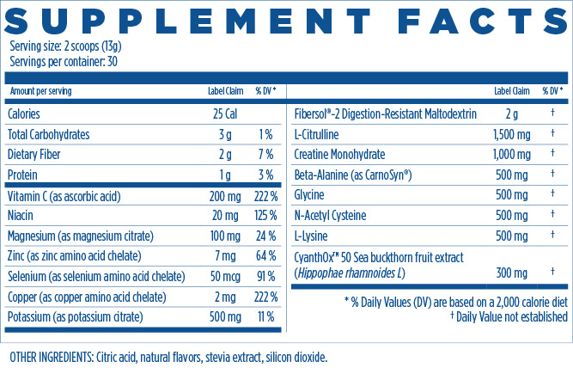
SET THE PACE FOR THE DAY AHEAD​​

Slide 7
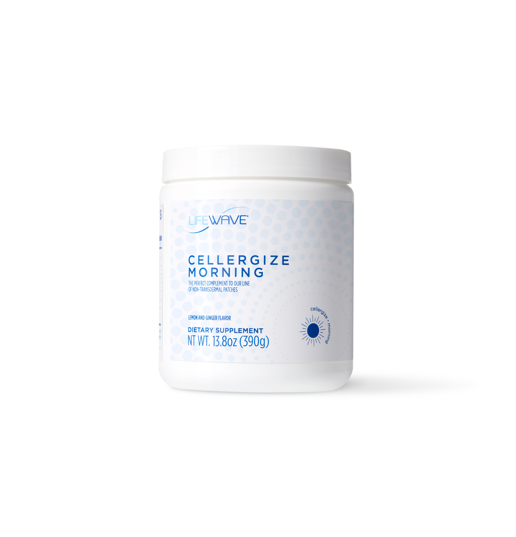
A SCOOP FULL OF BENEFITS
Supports the health and vitality of your stem cells* (CyanthOx, Copper)​​
Provides antioxidant support* (CyanthOx, NAC, Copper, Selenium, Vitamin C)​​
Supports production of glutathione* (NAC, Glycine, Selenium, Vitamin C, Magnesium)​​
Supports the formation of GHK-Cu* (Glycine, Copper)​​
Supports the formation of AHK-Cu* (Beta-alanine, Copper)​​
Supports immune function* (Zinc, Magnesium, NAC, Vitamin C, Copper, Selenium)​​
Supports cellular health* (Potassium, CyanthOx, NAC, Vitamin C, NAC, Selenium, Copper, Zinc)​​
Supports overall health and wellness* (Magnesium, Zinc, Vitamin C, FiberSol)​​
Contains prebiotic fiber* (FiberSol)​​​
*These statements have not been evaluated by the Food and Drug Administration. These products are not intended to diagnose, treat, cure, or prevent any disease.

Slide 8
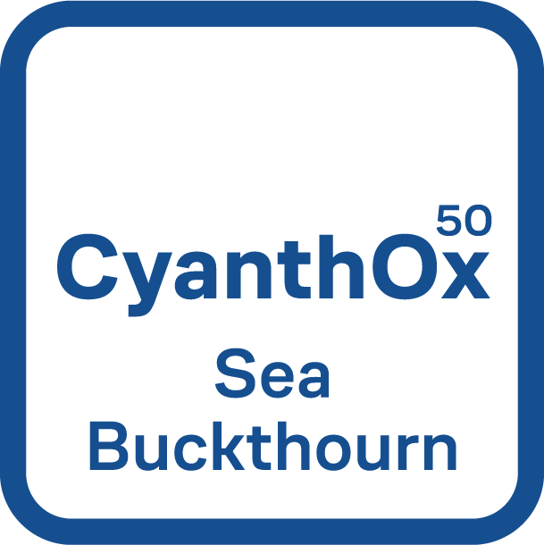

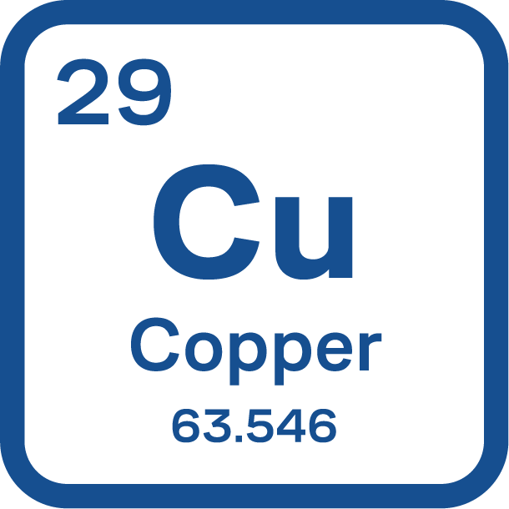


A SCOOP FULL OF BENEFITS
ANTIOXIDANT SUPPORT​
STEM CELL ACTIVITY
From CyanthOx, NAC, Copper, Selenium and Vitamin C:​
From CyanthOx:
Offers antioxidant support.*
Supports the health and vitality of your stem cells*
*These statements have not been evaluated by the Food and Drug Administration. These products are not intended to diagnose, treat, cure, or prevent any disease.

Slide 9
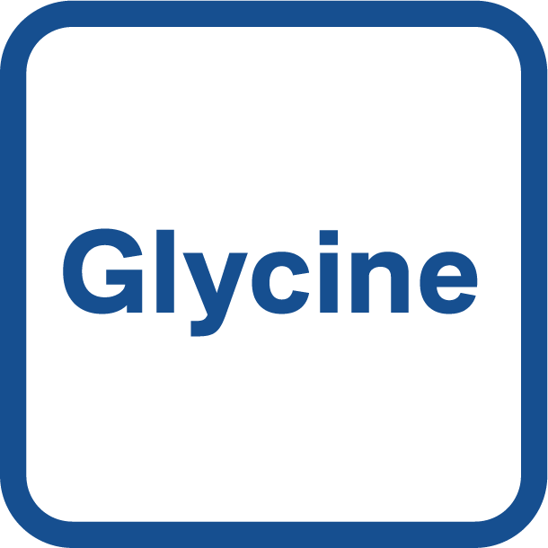

SUPPORTS PRODUCTION OF GLUTATHIONE
COPPER PEPTIDE SUPPORT
From NAC, Glycine, Selenium, Vitamin C, Magnesium:
From Glycine, Copper:​
Encourages the production of glutathione.*
Supports the formation of GHK-Cu*
*These statements have not been evaluated by the Food and Drug Administration. These products are not intended to diagnose, treat, cure, or prevent any disease.

Slide 10


COPPER PEPTIDE SUPPORT
SUPPORTS OVERALL WELLNESS
From Copper, Beta-Alanine :​
From Fiber:
Supports the formation of AHK-Cu*
Incorporates prebiotic fiber to your daily routine.*
*These statements have not been evaluated by the Food and Drug Administration. These products are not intended to diagnose, treat, cure, or prevent any disease.

Slide 11

IMMUNE FUNCTION SUPPORT​
From Zinc, Magnesium, NAC, Vitamin C, Copper, Selenium:
Supports immune function*
*These statements have not been evaluated by the Food and Drug Administration. These products are not intended to diagnose, treat, cure, or prevent any disease.

Slide 12
WHAT IS SEA BUCKTHORN?​
Sea buckthorn, known as “holy fruit” in Tibet, is found in centuries-old medicinal texts in Tibet and China. Recently, science has come to discover its dense nutritional content of omega 3 6 7 9, vitamins, and antioxidants.*
WHAT IS CYANTHOX™?​
CyanthOx™ is extracted from an ancient plant grown in Tibetan Plateau called sea buckthorn. Through millions of years of evolution, sea buckthorn is a treasure of bioactive nutrients. CyanthOx™ water-soluble extract is a unique and rich combination of polyphenols, proanthocyanidins, and bioflavonoids.*

Slide 13
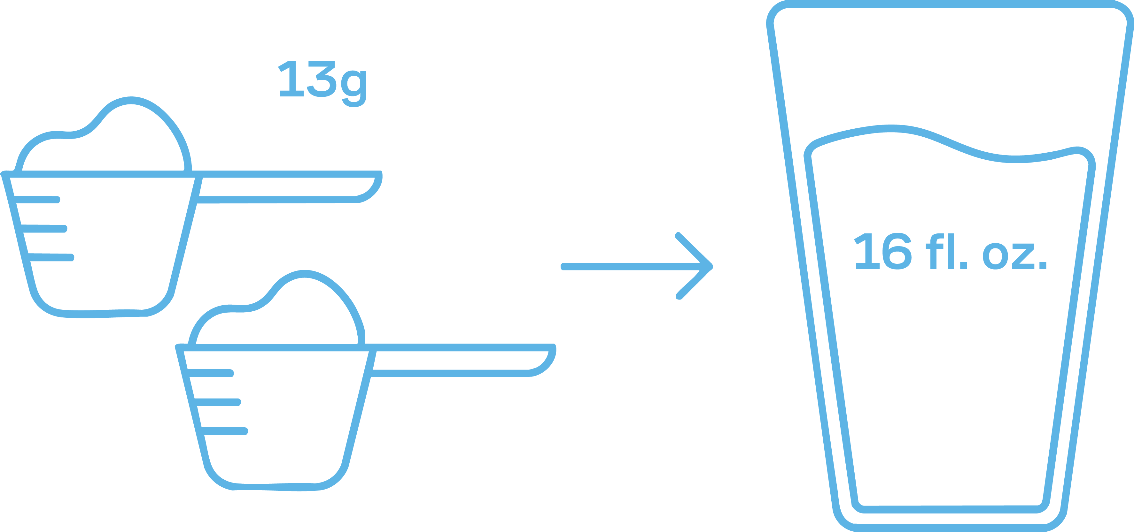
HOW TO USE
For one serving, mix 2 scoops (13g) with 16 fl. oz. (480ml) of clean, filtered water. Stir well until fully dissolved. For best results, consume in the morning, either on an empty stomach or with food.​​
CAUTIONS​
Use as directed. Do not exceed the stated dosage. Please consult your qualified healthcare professional before use, especially if pregnant, breastfeeding, taking medication or if you have a known medical condition. Suitable for individuals 18 years and over. Keep out of reach of children.​ Desiccant included.
HOW TO STORE​
Store in ambient temperature. Protect from heat, light and moisture. Do not use if canister seal is broken. Once opened, consume within 30 days for optimal freshness and quality.​​

Slide 14

SUPERCHARGE YOUR RESULTS WITH THE COMPLEMENTARY BENEFITS OF ​LIFEWAVE’S POWERFUL PATCH TECHNOLOGY​

Slide 15
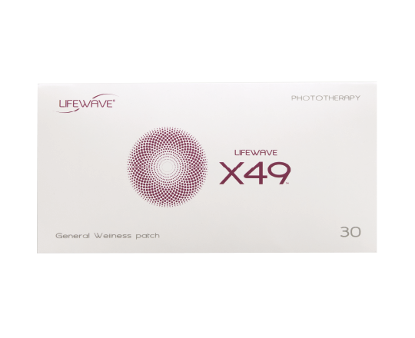
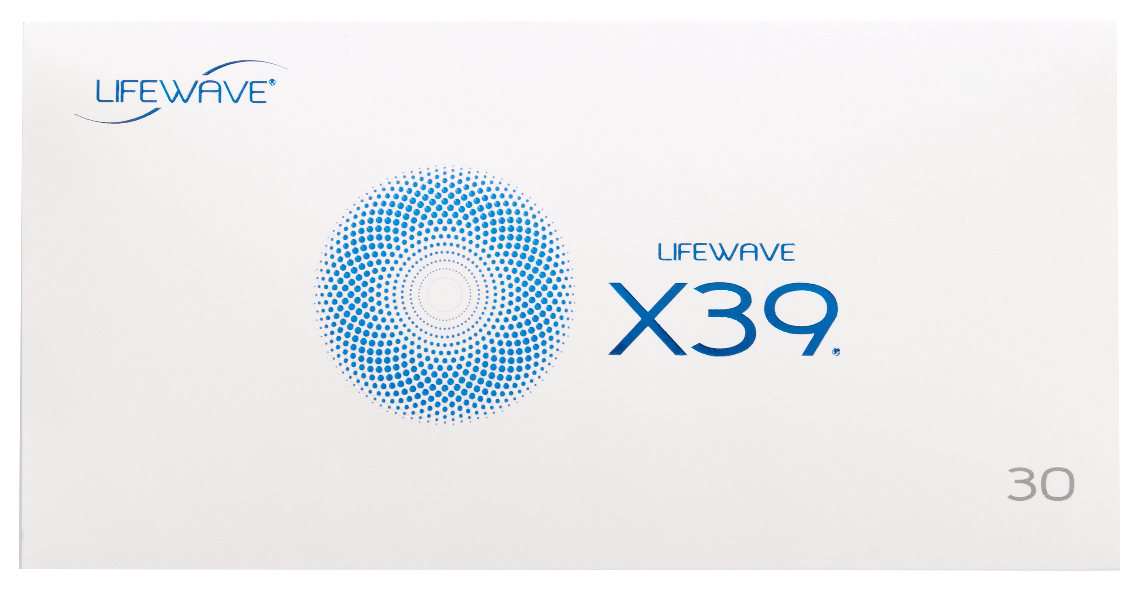
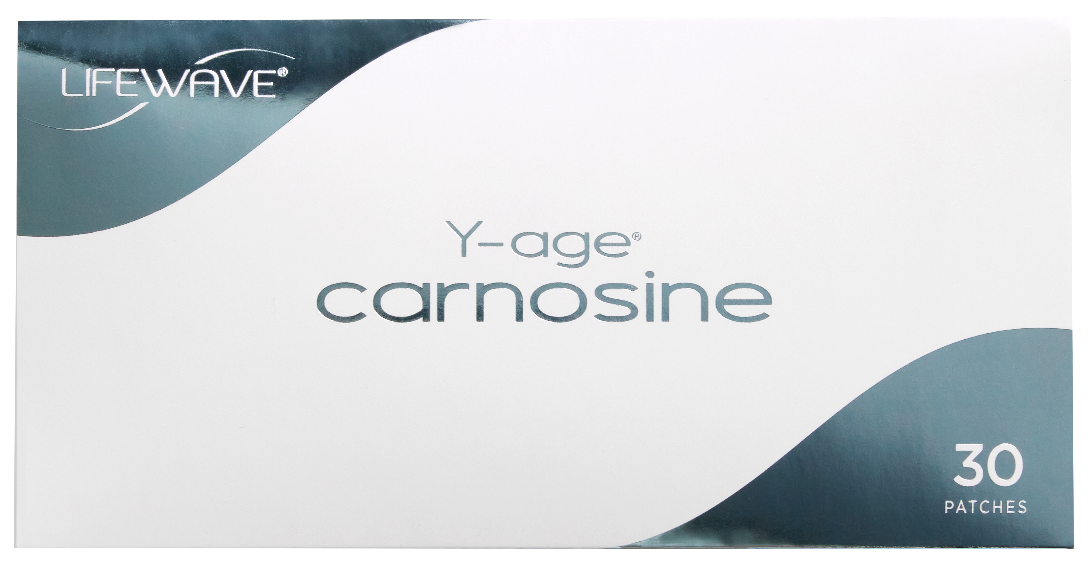
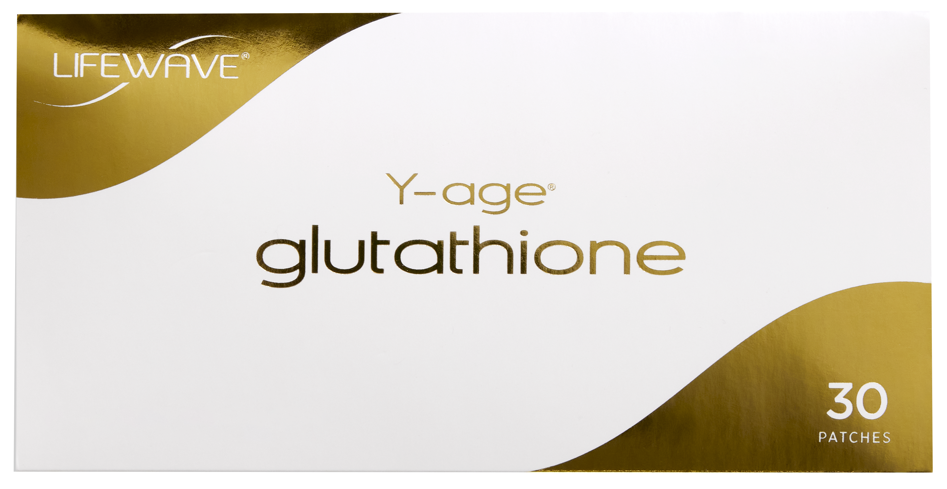
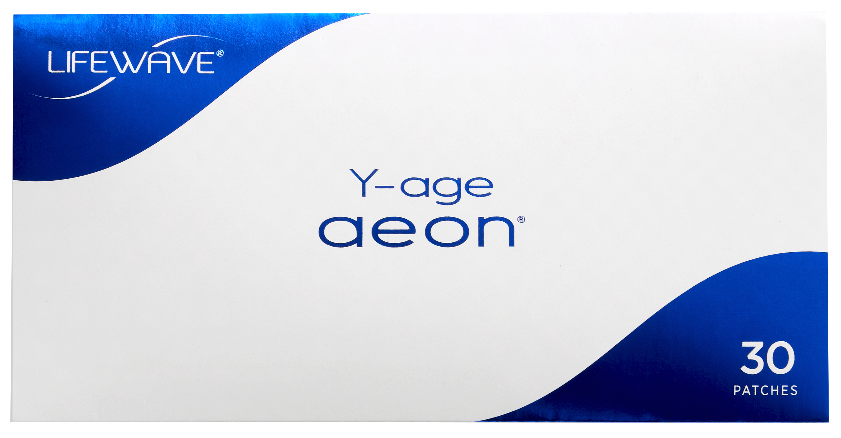
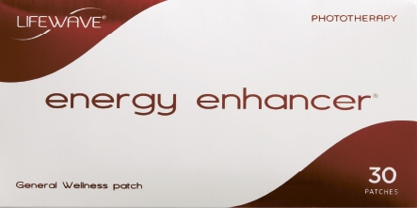
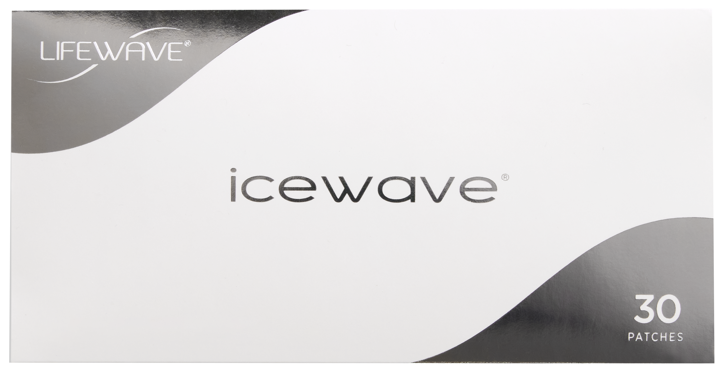

CELLERGIZE MORNING IS DESIGNED TO ELEVATE THE BENEFITS OF OUR DAYTIME RANGE OF NON-TRANSDERMAL PATCHES.​​

Slide 16
PRICING
 | 1 Unit |  |  | 2 Units (Price per Unit) |  |  | 3 Units (Price per Unit)
 | $ USD | BV | Retail Profit | $ USD | BV | Retail Profit | $ USD | BV | Retail Profit
BRAND PARTNER PRICING | $69.95 | 35 | - | $59.95 | 27 | - | $49.95 | 20 | -
PREFERRED CUSTOMER PRICING | $69.95 | 27 | $5 | $59.95 | 19 | $5 | $49.95 | 13 | $5
RETAIL CUSTOMER PRICING | $79.95 | 35 | $10 | $74.95 | 27 | $15 | $69.95 | 20 | $20

Slide 17

REAL RESULTS,
REAL STORIES
Hear from those who’ve tried it first-hand!

Slide 18

A SELECTION OF BRAND PARTNER TESTIMONIALS
“I’m so excited about Cellergize. Knowing these will help the performance of the patches is amazing!”
“I sampled Cellergize Morning and found that I felt this amazing energy flow from head to toe. Great taste! I am anxious for them to be ready for ordering.”
"I absolutely love the taste, and it gives me the perfect boost of energy and focus to tackle the day ahead!"
"I'm so excited to have these available to complement the patches and support overall wellness!"
"This product is absolutely extraordinary! I can’t wait for it to launch. With Cellergize, LifeWave X39 and the other patches feel like they work even more seamlessly together. I absolutely love this product!"
“Cellergize Morning is great. The taste was awesome. It picked me up in the morning.”

Slide 19




LIFEWAVE NUTRITION
CELLERGIZE MORNING
FOLLOW US
DISCLAIMER ​
LifeWave products are for general wellness and intended only to maintain or encourage a general state of health or a healthy activity. The content provide by LifeWave is presented in summary form, is general in nature, and is provided for informational purposes only. Always consult with your physician or other qualified health care provider before embarking on a new health regimen, diet or fitness program. Do not disregard any medical advice you have received or delay in seeking it. LifeWave reserves the right to change product prices or selection.
PROD-EN DECK R03

